Slide 1

ViralLoad System
Goals, Achievements, Work in Progress

Slide 2
Table of Contents
Viral Load/Goals
Achievements
  Tests Done
  Results Dispatched
Work in Progress
Summary

Slide 3
Viral Load/Goals
Viral Load Summary:
Set up to facilitate the capture and testing of Viral Load Samples as received from Facilities
System is currently only accessible from within CPHL at http://192.168.0.43/
Goals:
  Facilitate the testing of DBS, Whole Blood and Plasma Samples
  Facilitate the testing of samples on both Roche and Abbott Machines

Slide 4
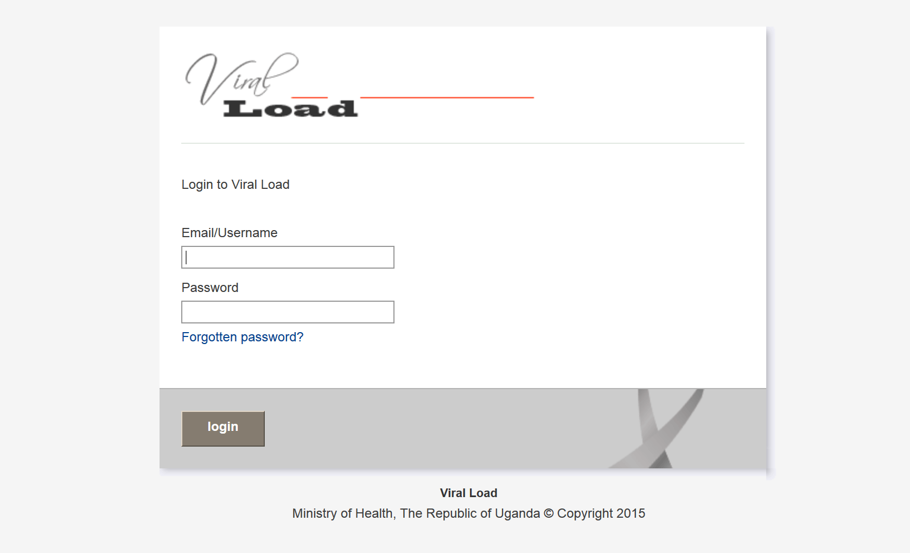
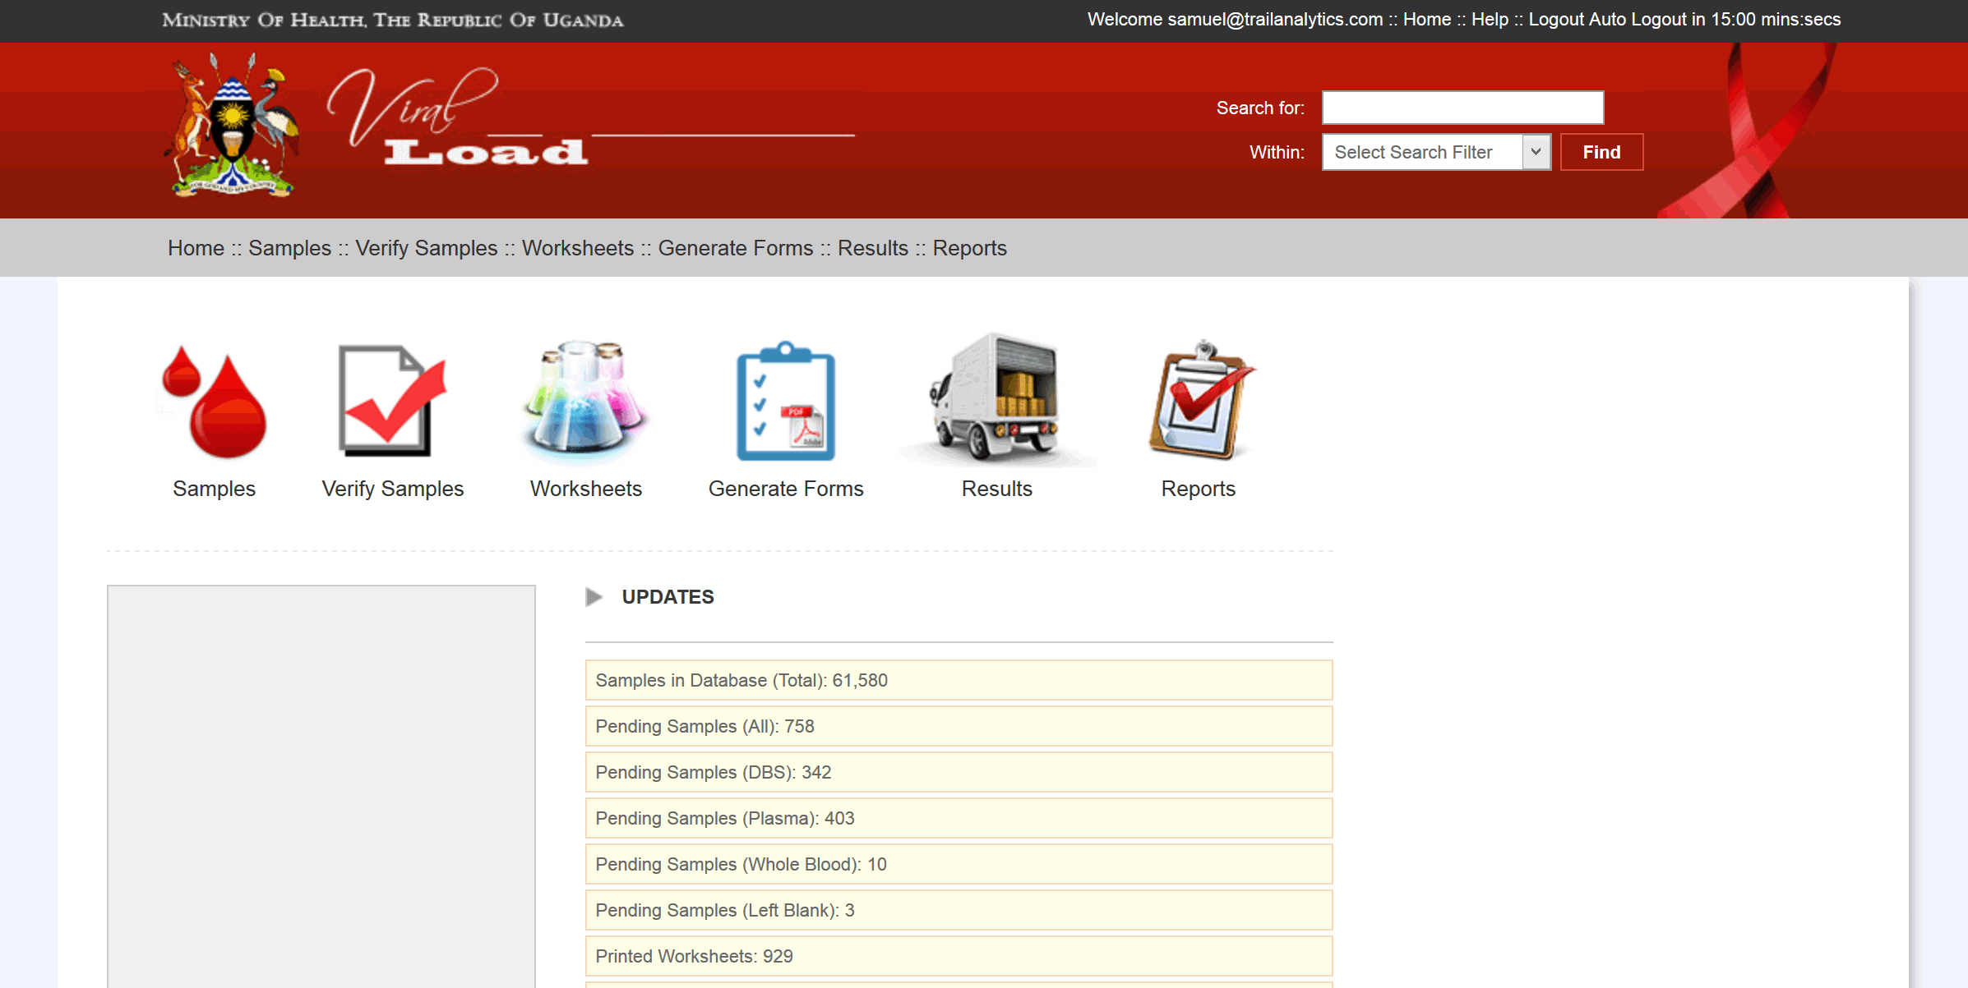
Viral Load

Slide 5
Achievements
Samples received to date:
# | Month/Year | DBS | Plasma | WholeBlood | LeftBlank | TOTAL
1 | August, 2014 | 0 | 161 | 30 | 0 | 191
2 | September, 2014 | 0 | 1,761 | 0 | 1 | 1,762
3 | October, 2014 | 0 | 1,556 | 0 | 0 | 1,556
4 | November, 2014 | 436 | 4,357 | 0 | 1 | 4,794
5 | December, 2014 | 2,626 | 5,482 | 0 | 0 | 8,108
6 | January, 2015 | 5,023 | 6,177 | 0 | 0 | 11,200
7 | February, 2015 | 7,855 | 8,595 | 0 | 0 | 16,450
8 | March, 2015 | 6,904 | 7,650 | 0 | 0 | 14,554
9 | April, 2015 | 2,745 | 4,078 | 0 | 1 | 6,824
 | TOTAL | 25,589 | 39,817 | 30 | 3 | 65,439

Slide 6
Achievements
Samples tested to date (includes repeat tests):
# | Month/Year | Abbott | Roche | TOTAL
1 | August, 2014 | 437 | 22 | 459
2 | September, 2014 | 1,524 | 0 | 1,524
3 | October, 2014 | 115 | 2,003 | 2,118
4 | November, 2014 | 2,169 | 1,650 | 3,819
5 | December, 2014 | 3,806 | 3,639 | 7,445
6 | January, 2015 | 11,850 | 106 | 11,956
7 | February, 2015 | 15,130 | 84 | 15,214
8 | March, 2015 | 19,246 | 225 | 19,471
9 | April, 2015 | 7,486 | 0 | 7,486
 | TOTAL | 61,763 | 7,729 | 69,492

Slide 7
Work in Progress
Replication of (internal) ViralLoad System with online dashboard to enable access to the Dashboard/ViralLoad System from outside of CPHL
Enhancement of ViralLoad Dashboard with additional statistics e.g Turn Around Times
Addition of data validation/logical checks to the sample data entry process

Slide 8
- End -

